Slide 1
Power BI Adoption Framework
Empower every decision maker
User Identity in Power BI

Slide 2



User Identity
Runs on Azure
Azure Active Directory
Users and Groups

Slide 3



User Identity
Managed Identities
Federated Identities
On-Premises Directory

Slide 4


Power BI Authentication
ATM (Azure Traffic Manager)
AAD
Azure CDN
WFE
Global Service
(Azure Table)
ASP.NET
Backend Service
Browser
app.powerbi.com
Microsoft Login

Slide 5
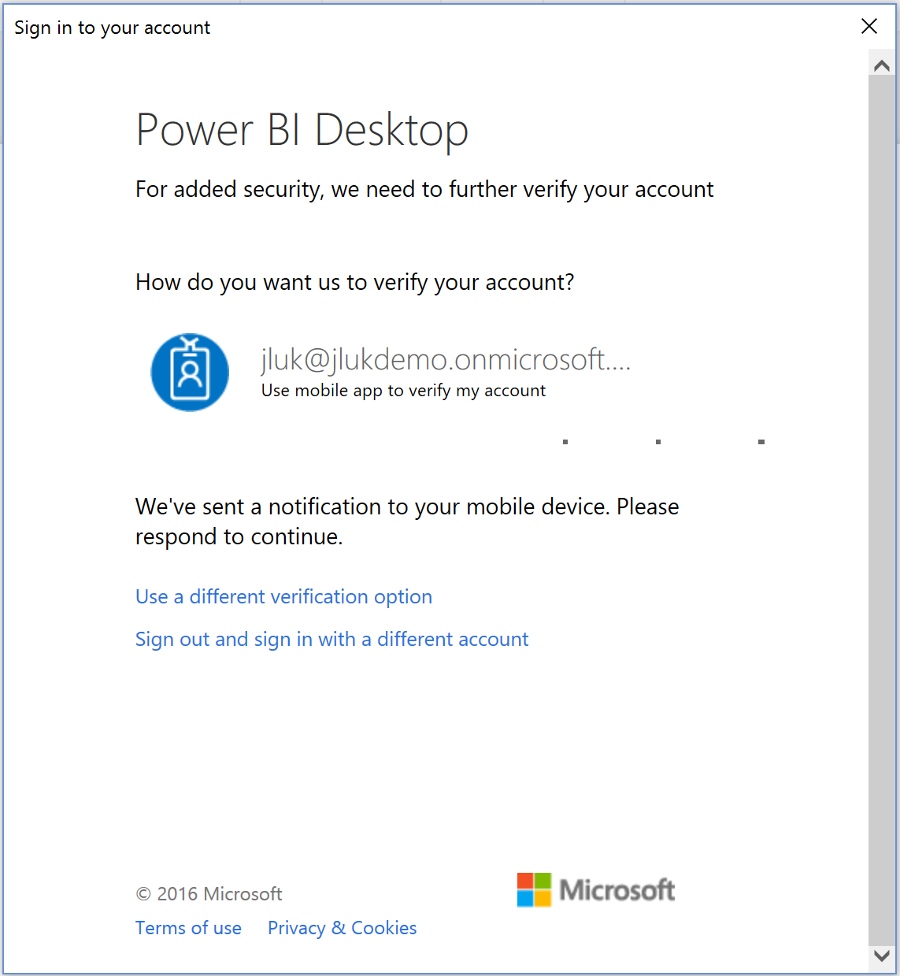



Multi-Factor Authentication
Office 365 / AAD Premium
Phone Call
Text
App

Slide 6
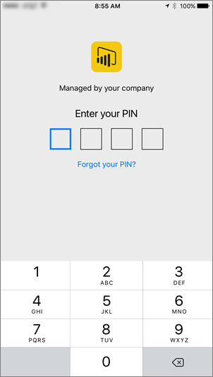


User Access Control
Mobile Device Policies
Intune
Company Portal

Slide 7


Conditional Access
IP Addresses (corp net)
Devices
Users / Groups
Multi-factor Auth

Slide 8



Admin Control
Self Sign-Up
Sharing
Exporting

Slide 9
Do you want to add controls for Power BI Environment Access?
Do you want users to be able to access non-corporate tenants?
Block access to Office 365 tenant
Do you want to have 2 factor authentication for user access?
Review / purchase licenses that include MFA, like Azure Active Directory Premium
Enable MFA in the Office 365 Admin Centre for all required users
Do you want to disable self sign-up for Power BI?
Disable this feature at O365 level

Slide 10
Marketplace Offerings
Notes:
https://appsource.microsoft.com/en-gb/marketplace/consulting-services?product=power-bi

Slide 11
Thank you

